Slide 1



Lecture Slides
Chapter 6
Fatigue Failure Resulting from Variable Loading
© 2015 by McGraw-Hill Education. This is proprietary material solely for authorized instructor use. Not authorized for sale or distribution in any manner. This document may not be copied, scanned, duplicated, forwarded, distributed, or posted on a website, in whole or part.

Slide 2
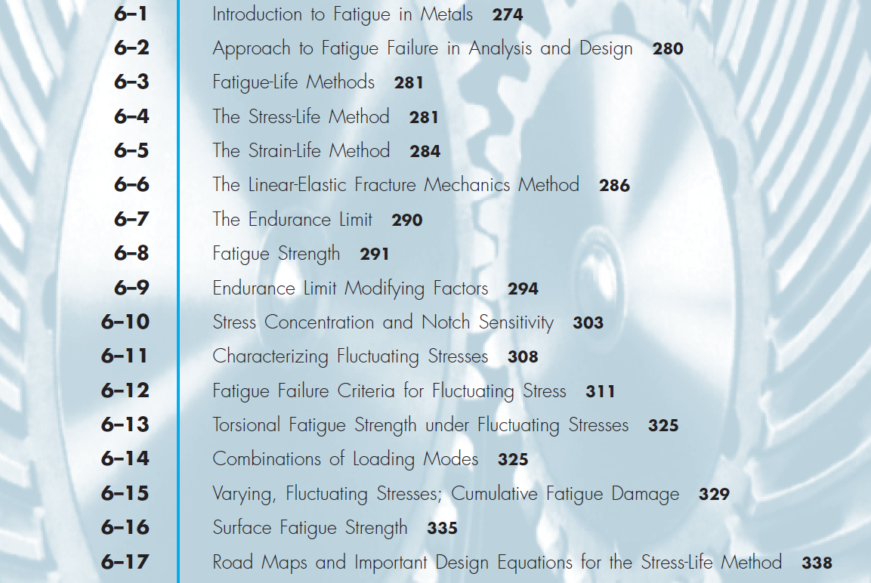
Chapter Outline

Slide 3
Introduction to Fatigue in Metals
Loading produces stresses that are variable, repeated, alternating, or fluctuating
Maximum stresses well below yield strength
Failure occurs after many stress cycles
Failure is by sudden ultimate fracture
No visible warning in advance of failure

Slide 4
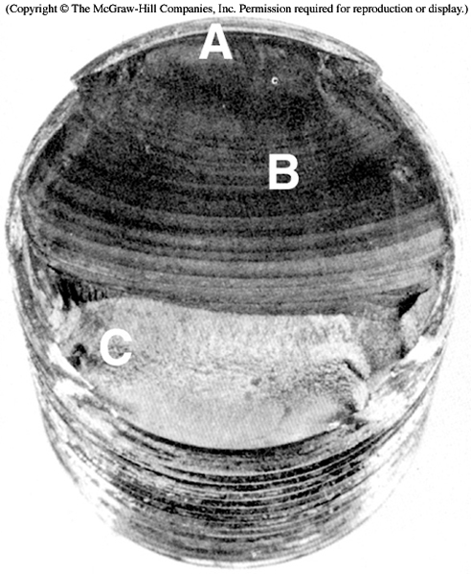
Stages of Fatigue Failure
Stage I – Initiation of micro-crack due to cyclic plastic deformation
Stage II – Progresses to macro-crack that repeatedly opens and closes, creating bands called beach marks
Stage III – Crack has propagated far enough that remaining material is insufficient to carry the load, and fails by simple ultimate failure
Fig. 6–1

Slide 5
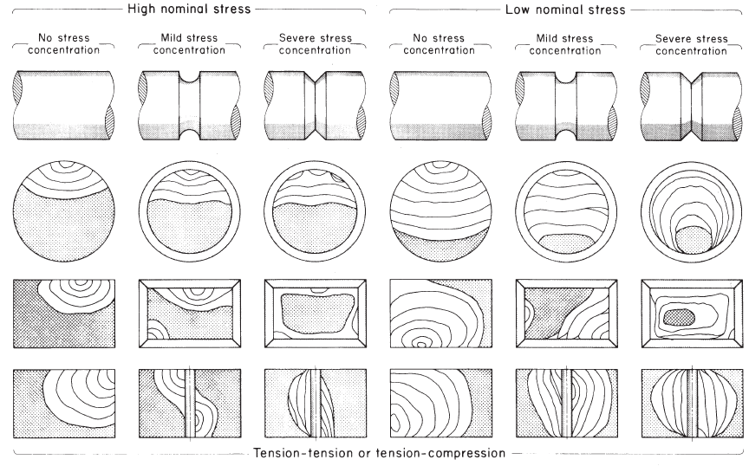
Schematics of Fatigue Fracture Surfaces
Fig. 6–2

Slide 6
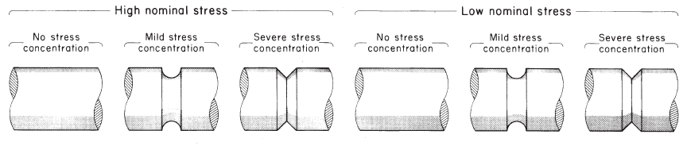
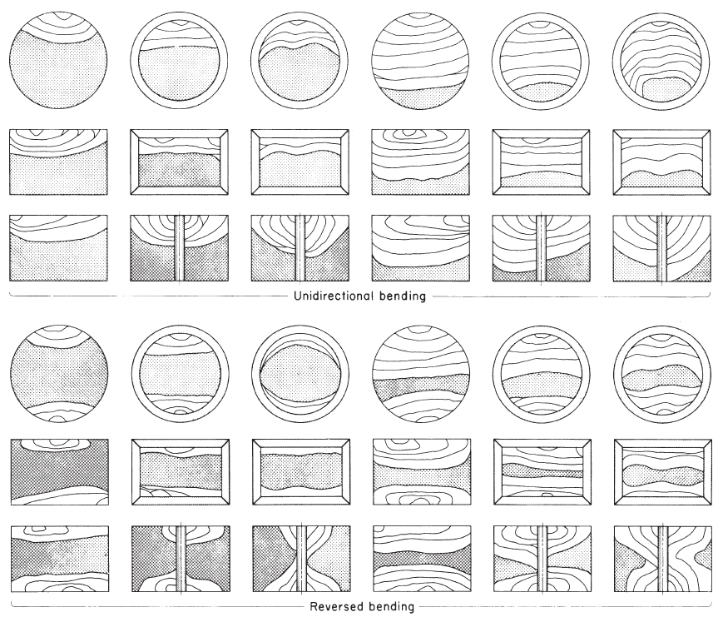
Schematics of Fatigue Fracture Surfaces
Fig. 6–2

Slide 7
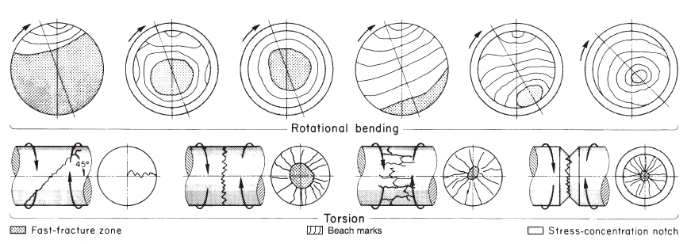
Schematics of Fatigue Fracture Surfaces
Fig. 6–2

Slide 8
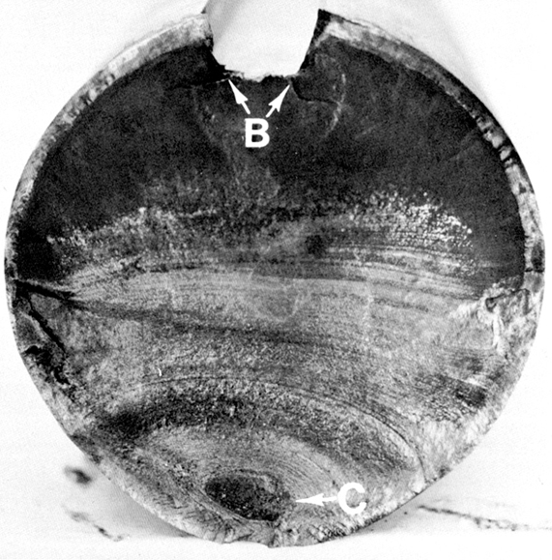
Fatigue Fracture Examples
AISI 4320 drive shaft
B– crack initiation at stress concentration in keyway
C– Final brittle failure
Fig. 6–3

Slide 9
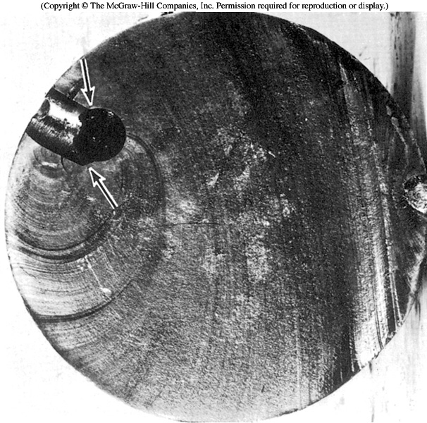
Fatigue Fracture Examples
Fatigue failure initiating at mismatched grease holes
Sharp corners (at arrows) provided stress concentrations
Fig. 6–4

Slide 10
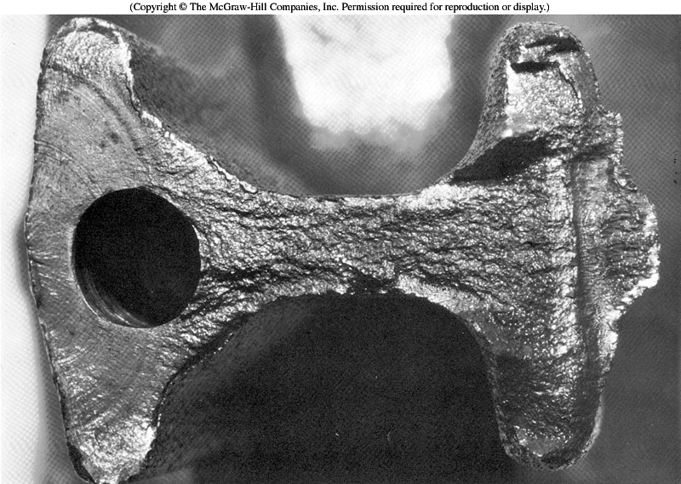
Fatigue Fracture Examples
Fatigue failure of forged connecting rod
Crack initiated at flash line of the forging at the left edge of picture
Beach marks show crack propagation halfway around the hole before ultimate fracture
Fig. 6–5

Slide 11
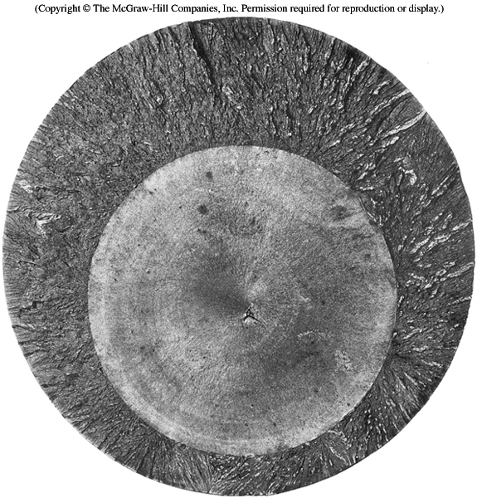
Fatigue Fracture Examples
Fatigue failure of a 200-mm diameter piston rod of an alloy steel steam hammer
Loaded axially
Crack initiated at a forging flake internal to the part
Internal crack grew outward symmetrically
Fig. 6–6

Slide 12
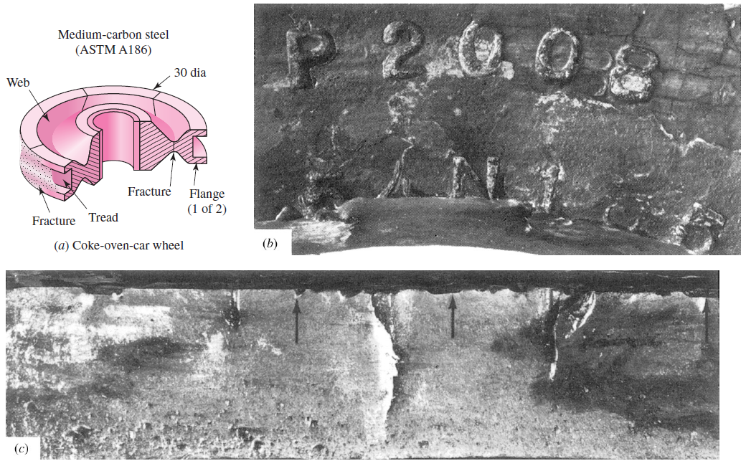
Fatigue Fracture Examples
Double-flange trailer wheel
Cracks initiated at stamp marks
Fig. 6–7

Slide 13
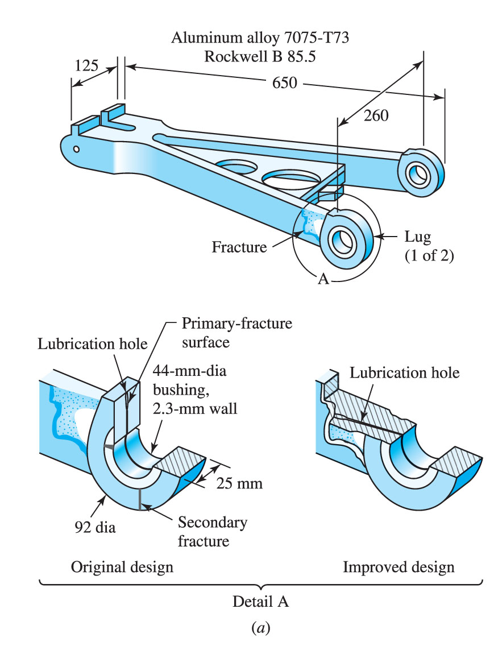
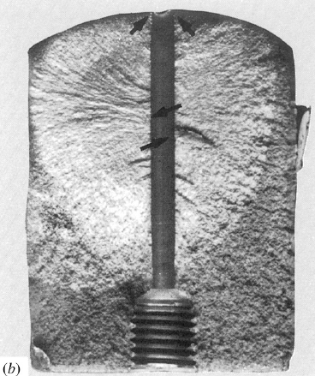
Fatigue Fracture Examples
Aluminum allow landing-gear torque-arm assembly redesign to eliminate fatigue fracture at lubrication hole
Fig. 6–8

Slide 14
Fatigue-Life Methods
Three major fatigue life models
Methods predict life in number of cycles to failure, N, for a specific level of loading
Stress-life method
Least accurate, particularly for low cycle applications
Most traditional, easiest to implement
Strain-life method
Detailed analysis of plastic deformation at localized regions
Several idealizations are compounded, leading to uncertainties in results
Linear-elastic fracture mechanics method
Assumes crack exists
Predicts crack growth with respect to stress intensity

Slide 15
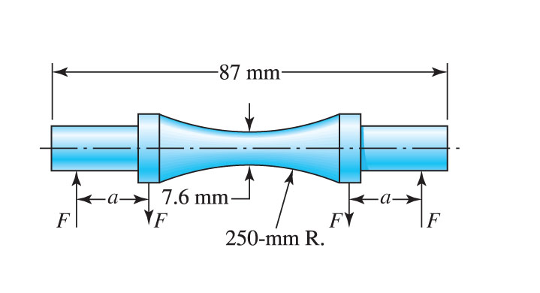
Stress-Life Method
Test specimens are subjected to repeated stress while counting cycles to failure
Most common test machine is R. R. Moore high-speed rotating-beam machine
Subjects specimen to pure bending with no transverse shear
As specimen rotates, stress fluctuates between equal magnitudes of tension and compression, known as completely reversed stress cycling
Specimen is carefully machined and polished
Fig. 6–9

Slide 16
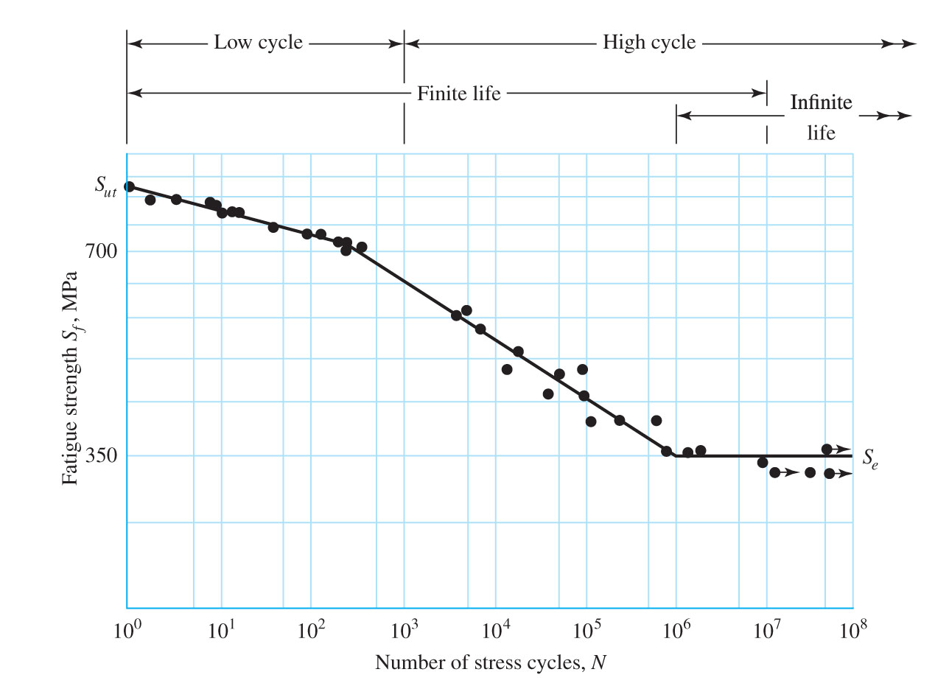
S-N Diagram
Number of cycles to failure at varying stress levels is plotted on log-log scale
For steels, a knee occurs near 10⁶ cycles
Strength corresponding to the knee is called endurance limit S_{e}
Fig. 6–10

Slide 17
S-N Diagram for Steel
Stress levels below S_{e} predict infinite life
Between 10³ and 10⁶ cycles, finite life is predicted
Below 10³ cycles is known as low cycle, and is often considered quasi-static. Yielding usually occurs before fatigue in this zone.
Fig. 6–10

Slide 18
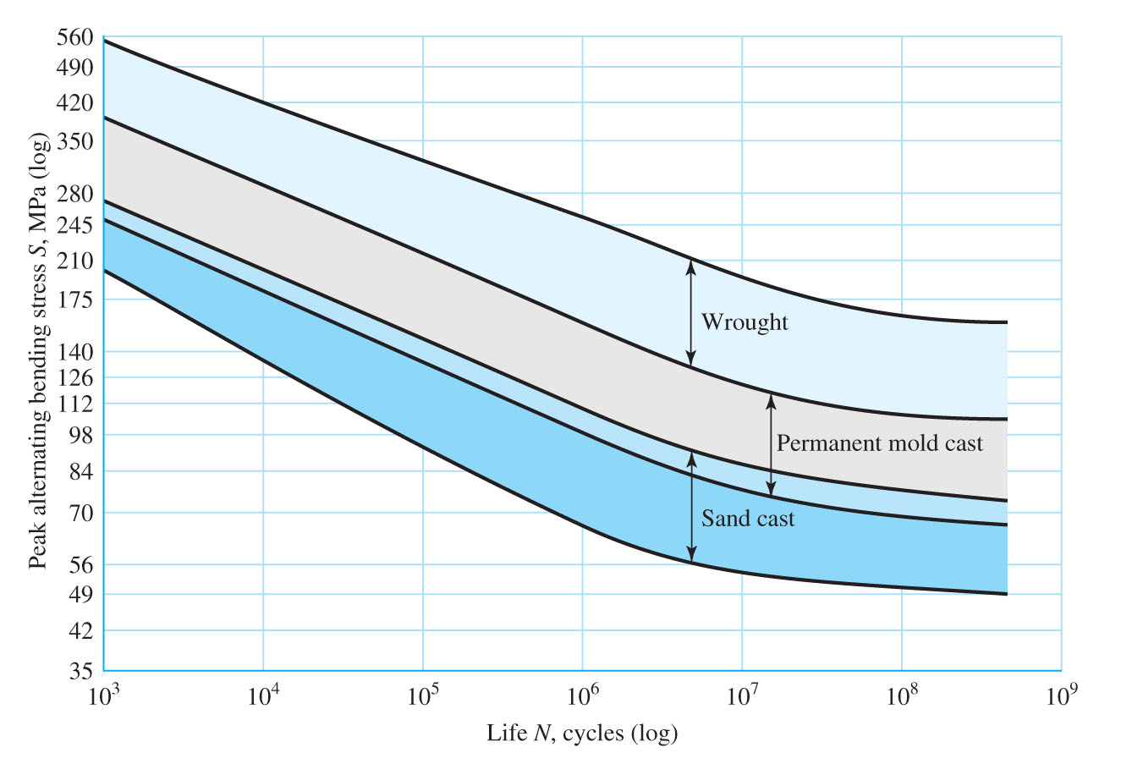
S-N Diagram for Nonferrous Metals
Nonferrous metals often do not have an endurance limit.
Fatigue strength S_{f} is reported at a specific number of cycles
Figure 6–11 shows typical S-N diagram for aluminums
Fig. 6–11

Slide 19
Strain-Life Method
Method uses detailed analysis of plastic deformation at localized regions
Compounding of several idealizations leads to significant uncertainties in numerical results
Useful for explaining nature of fatigue

Slide 20
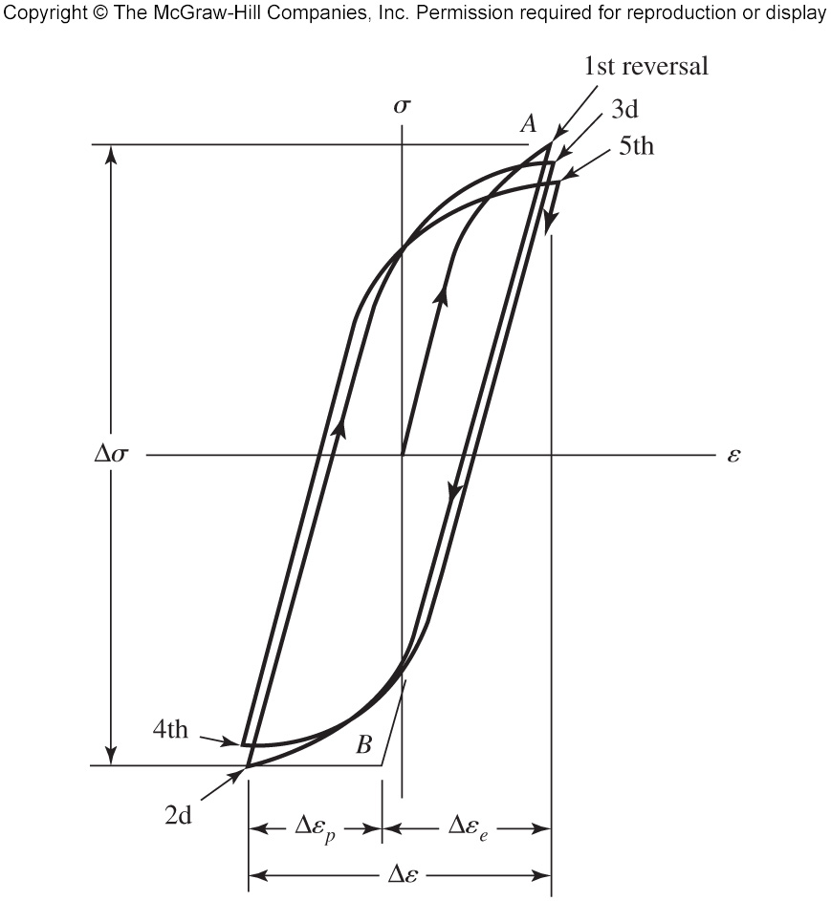
Strain-Life Method
Fatigue failure almost always begins at a local discontinuity
When stress at discontinuity exceeds elastic limit, plastic strain occurs
Cyclic plastic strain can change elastic limit, leading to fatigue
Fig. 6–12 shows true stress-true strain hysteresis loops of the first five stress reversals
Fig. 6–12

Slide 21
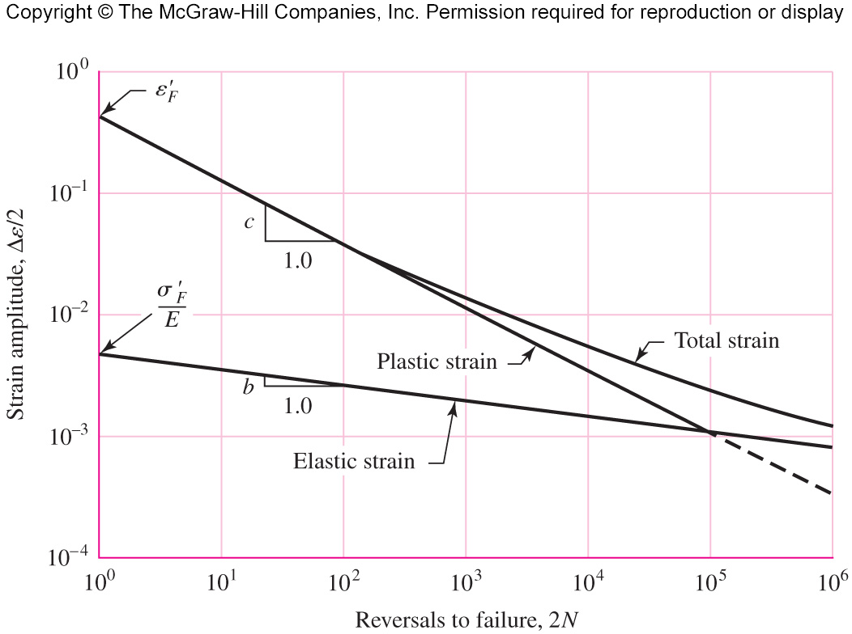
Relation of Fatigue Life to Strain
Figure 6–13 plots relationship of fatigue life to true-strain amplitude
Fatigue ductility coefficient ε'_{F} is true strain corresponding to fracture in one reversal (point A in Fig. 6–12)
Fatigue strength coefficient σ'_{F} is true stress corresponding to fracture in one reversal (point A in Fig. 6–12)
Fig. 6–13

Slide 22
Relation of Fatigue Life to Strain
Fatigue ductility exponent c is the slope of plastic-strain line, and is the power to which the life 2N must be raised to be proportional to the true plastic-strain amplitude. Note that 2N stress reversals corresponds to N cycles.
Fatigue strength exponent b is the slope of the elastic-strain line, and is the power to which the life 2N must be raised to be proportional to the true-stress amplitude.
Fig. 6–13

Slide 23
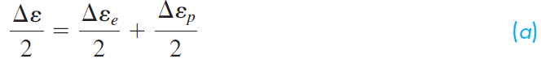
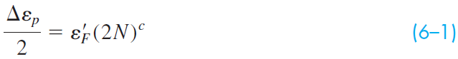
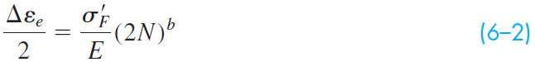
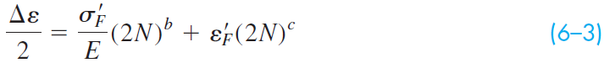
Relation of Fatigue Life to Strain
Total strain is sum of elastic and plastic strain
Total strain amplitude is half the total strain range
The equation of the plastic-strain line in Fig. 6–13
The equation of the elastic strain line in Fig. 6–13
Applying Eq. (a), the total-strain amplitude is

Slide 24
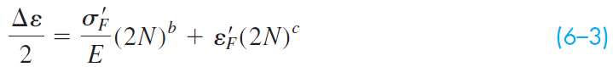
Relation of Fatigue Life to Strain
Known as Manson-Coffin relationship between fatigue life and total strain
Some values of coefficients and exponents given in Table A–23
Equation has limited use for design since values for total strain at discontinuities are not readily available

Slide 25
Linear-Elastic Fracture Mechanics Method
Assumes Stage I fatigue (crack initiation) has occurred
Predicts crack growth in Stage II with respect to stress intensity
Stage III ultimate fracture occurs when the stress intensity factor K_{I} reaches some critical level K_{Ic}

Slide 26
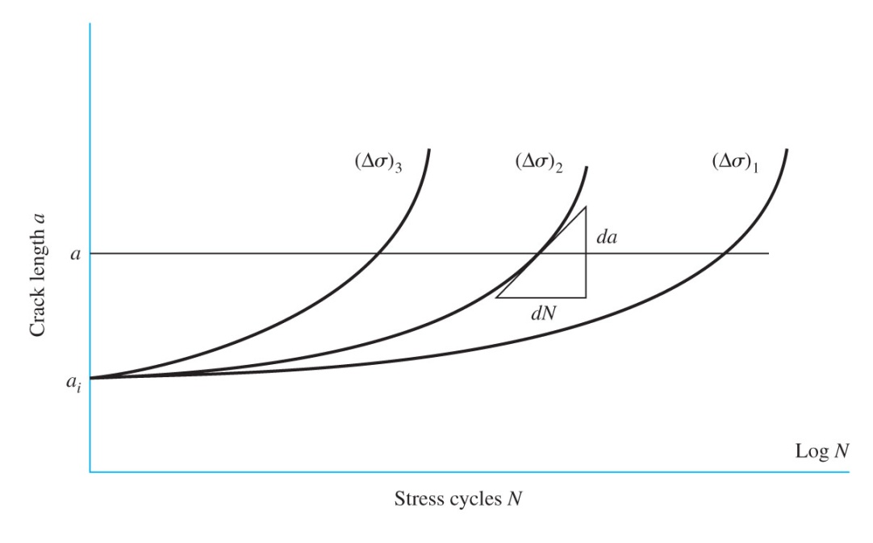
Crack Growth
Stress intensity factor is given by
For a stress range Δσ, the stress intensity range per cycle is
Testing specimens at various levels of Δσ provide plots of crack length vs. stress cycles
Fig. 6–14

Slide 27
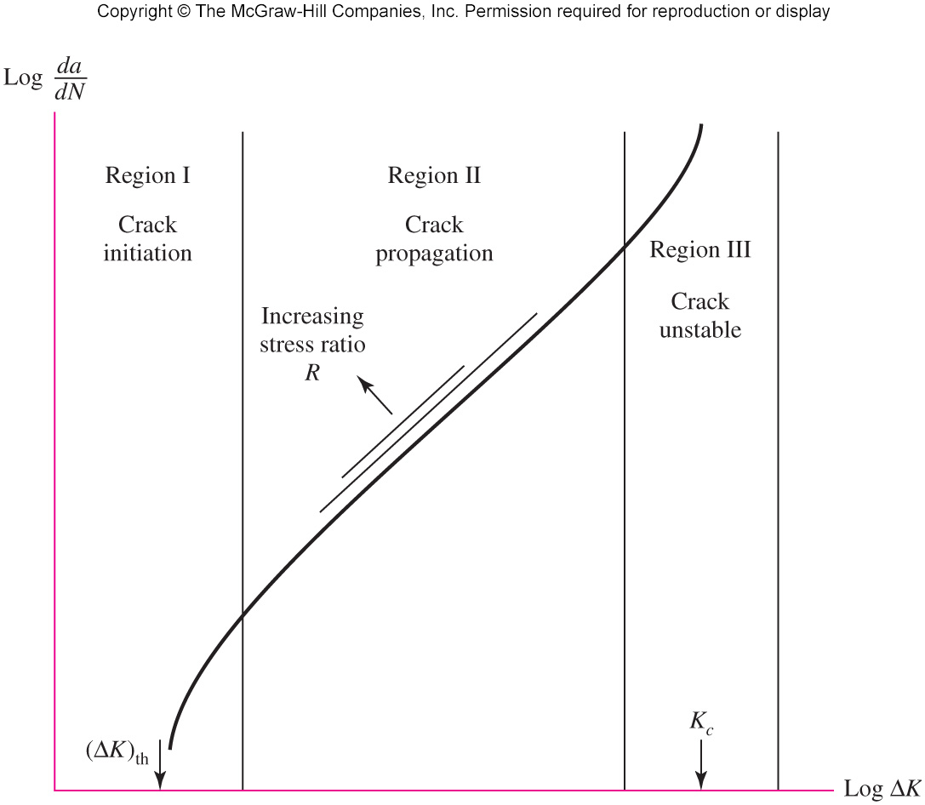
Crack Growth
Log-log plot of rate of crack growth, da/dN, shows all three stages of growth
Stage II data are linear on log-log scale
Similar curves can be generated by changing the stress ratio R = σ_{min}/ σ_{max}
Fig. 6–15

Slide 28
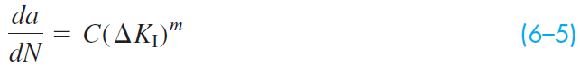
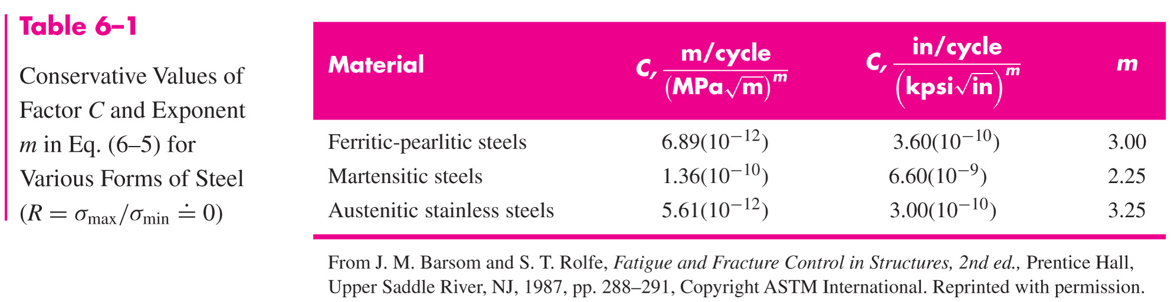
Crack Growth
Crack growth in Region II is approximated by the Paris equation
C and m are empirical material constants. Conservative representative values are shown in Table 6–1.

Slide 29
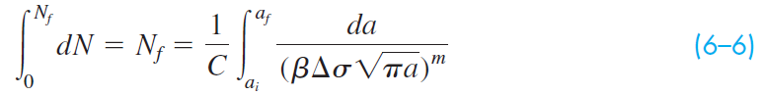
Crack Growth
Substituting Eq. (6–4) into Eq. (6–5) and integrating,
a_{i} is the initial crack length
a_{f} is the final crack length corresponding to failure
N_{f} is the estimated number of cycles to produce a failure after the initial crack is formed

Slide 30
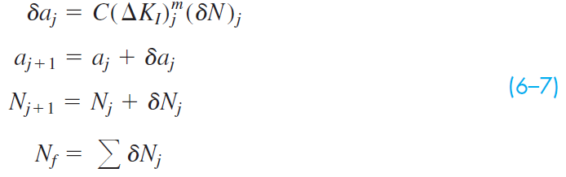
Crack Growth
If β is not constant, then the following numerical integration algorithm can be used.

Slide 31
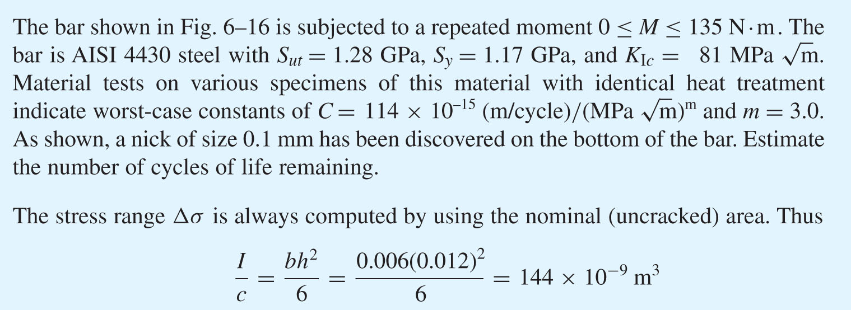
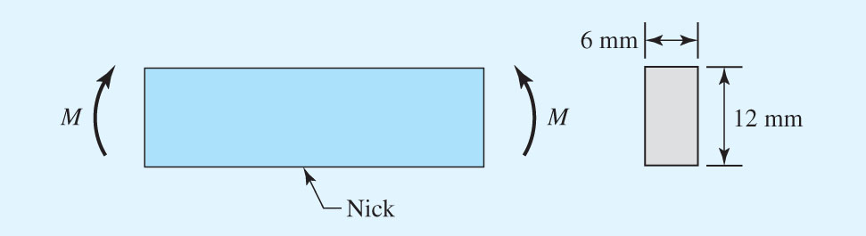
Example 6–1
Fig. 6–16

Slide 32
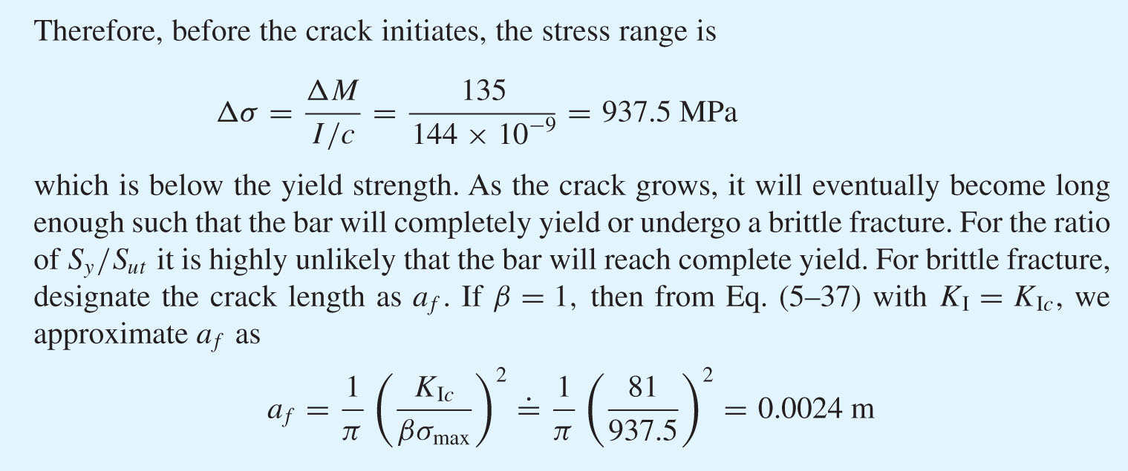
Example 6–1 (continued)

Slide 33
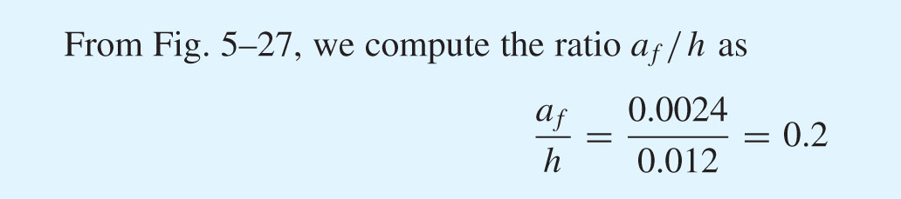
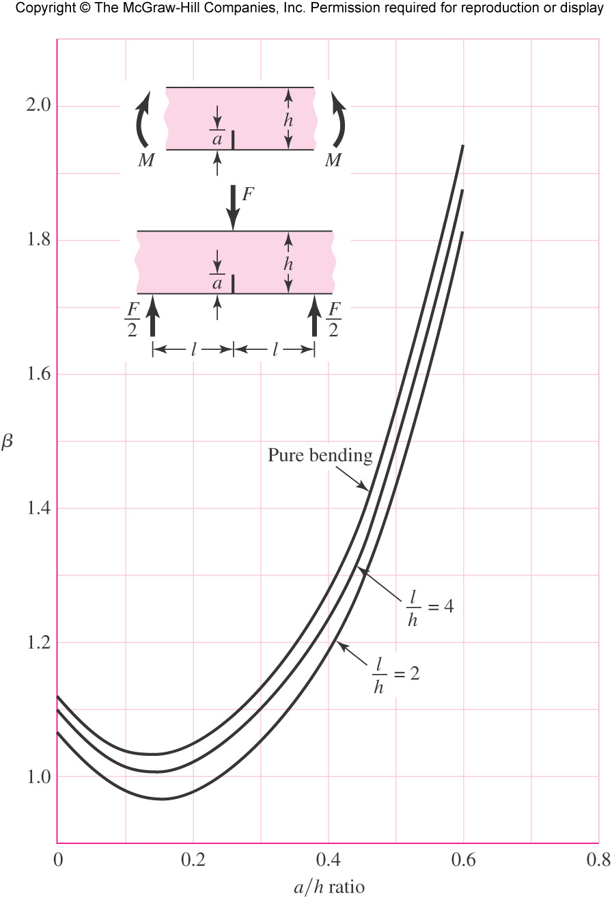
Example 6–1 (continued)
Fig. 5–27

Slide 34
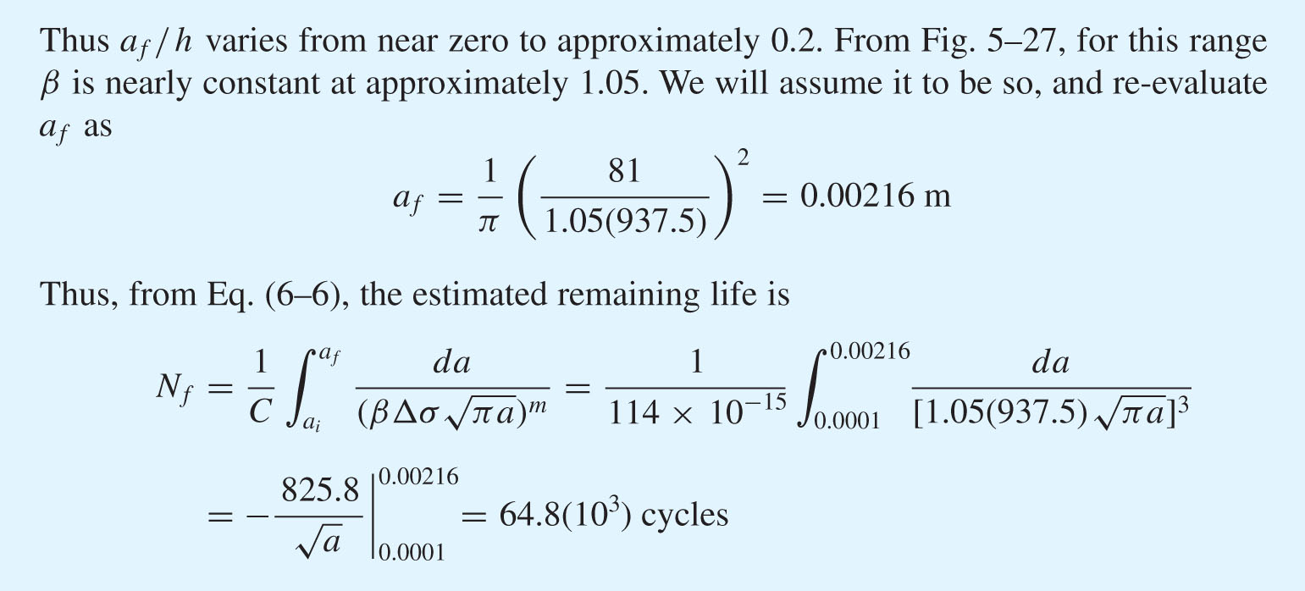
Example 6–1 (continued)

Slide 35
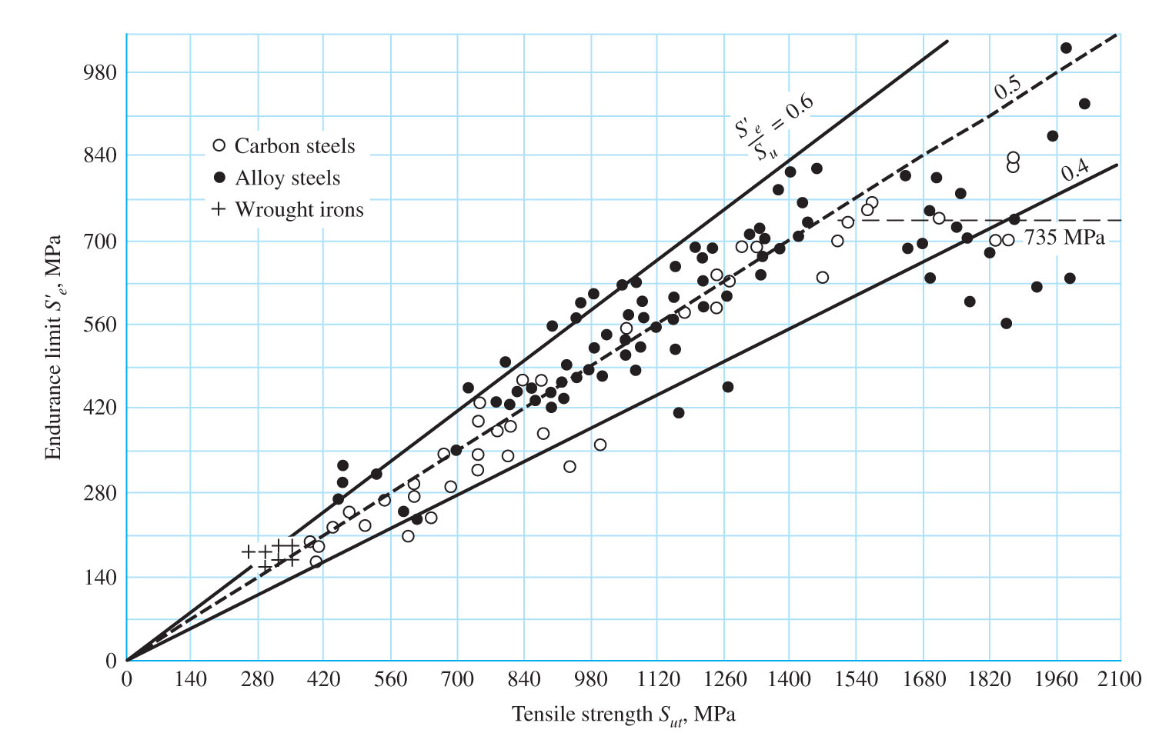
The Endurance Limit
The endurance limit for steels has been experimentally found to be related to the ultimate strength
Fig. 6–17

Slide 36
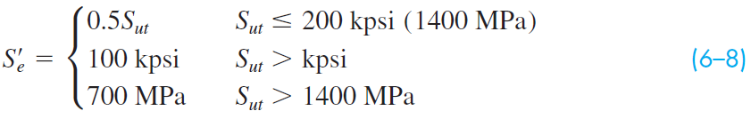
The Endurance Limit
Simplified estimate of endurance limit for steels for the rotating-beam specimen, S'_{e}
Fig. 6–17

Slide 37
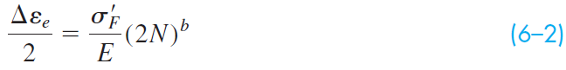
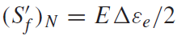
Fatigue Strength
For design, an approximation of the idealized S-N diagram is desirable.
To estimate the fatigue strength at 10³ cycles, start with Eq. (6–2)
Define the specimen fatigue strength at a specific number of cycles as
Combine with Eq. (6–2),

Slide 38
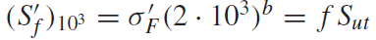
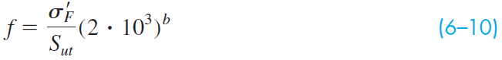
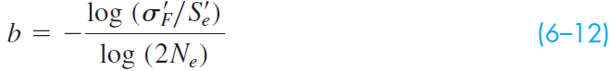
Fatigue Strength
At 10³ cycles,
f is the fraction of S_{ut} represented by
Solving for f,
The SAE approximation for steels with H_{B} ≤ 500 may be used.
To find b, substitute the endurance strength and corresponding cycles into Eq. (6–9) and solve for b

Slide 39
Fatigue Strength
Eqs. (6–11) and (6–12) can be substituted into Eqs. (6–9) and (6–10) to obtain expressions for S'_{f} and f

Slide 40
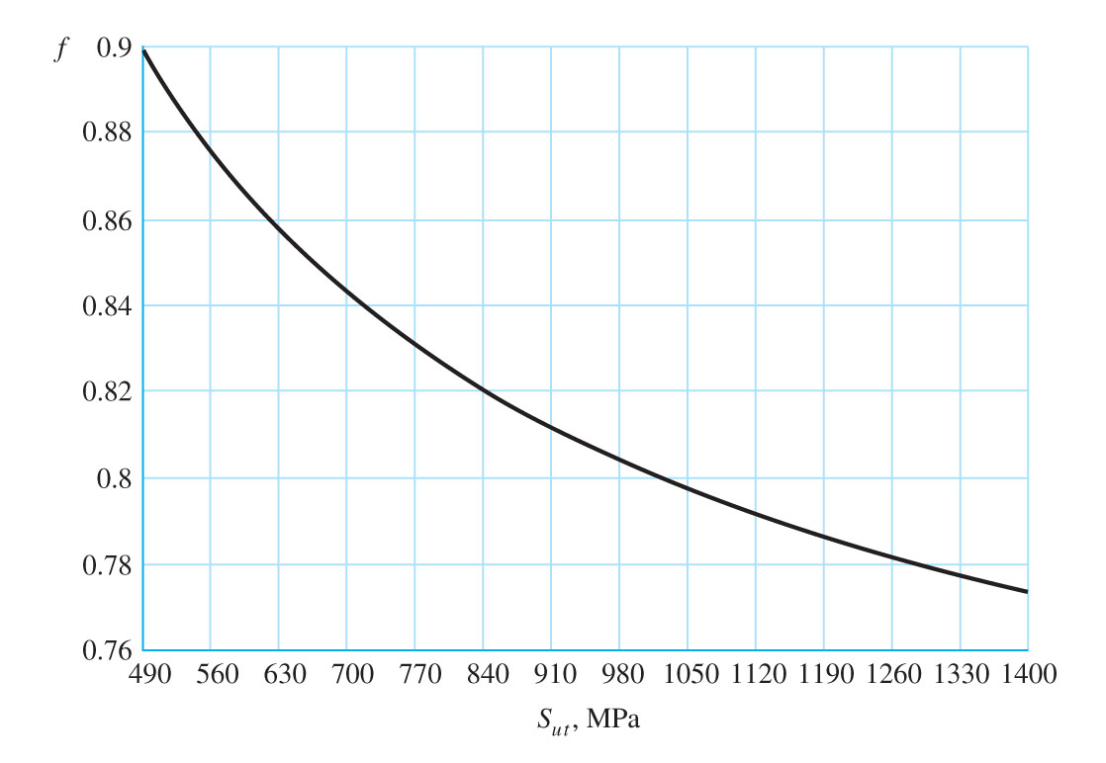
Fatigue Strength Fraction f
Plot Eq. (6–10) for the fatigue strength fraction f of S_{ut} at 10³ cycles
Use f from plot for S'_{f} = f S_{ut} at 10³ cycles on S-N diagram
Assumes S_{e} = S'_{e}= 0.5S_{ut} at 10⁶ cycles
Fig. 6–18

Slide 41
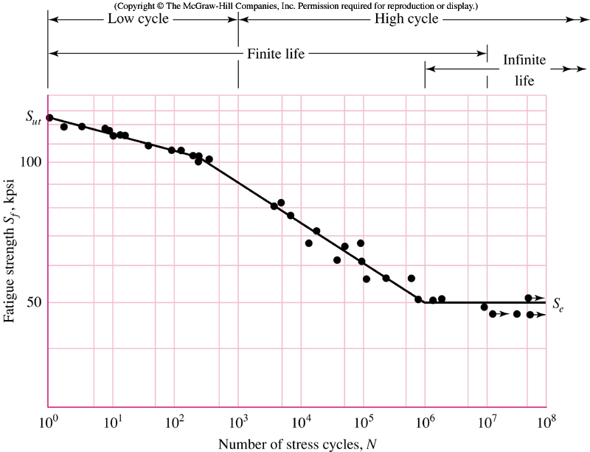
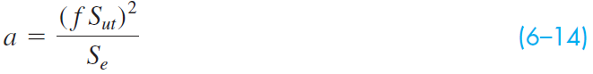
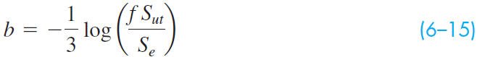
Equations for S-N Diagram
Write equation for S-N line from 10³ to 10⁶ cycles
Two known points
At N =10³ cycles, S_{f} = f S_{ut}
At N =10⁶ cycles, S_{f} = S_{e}
Equations for line:
Fig. 6–10

Slide 42
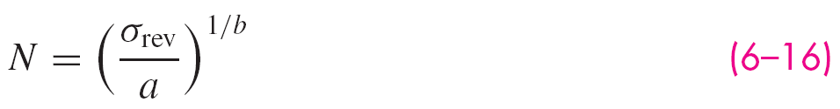
Equations for S-N Diagram
If a completely reversed stress σ_{rev} is given, setting S_{f} = σ_{rev} in Eq. (6–13) and solving for N gives,
Note that the typical S-N diagram is only applicable for completely reversed stresses
For other stress situations, a completely reversed stress with the same life expectancy must be used on the S-N diagram

Slide 43
Low-cycle Fatigue
Low-cycle fatigue is defined for fatigue failures in the range 1 ≤ N ≤ 10³
On the idealized S-N diagram on a log-log scale, failure is predicted by a straight line between two points (10³, f S_{ut}) and (1, S_{ut})

Slide 44
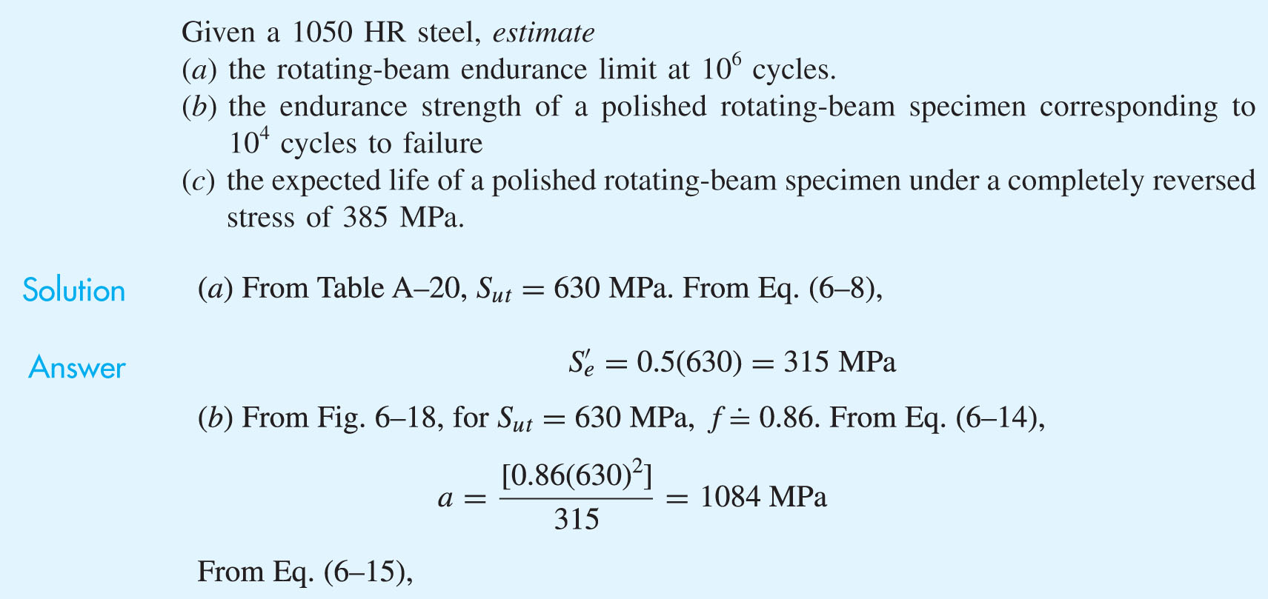
Example 6–2

Slide 45
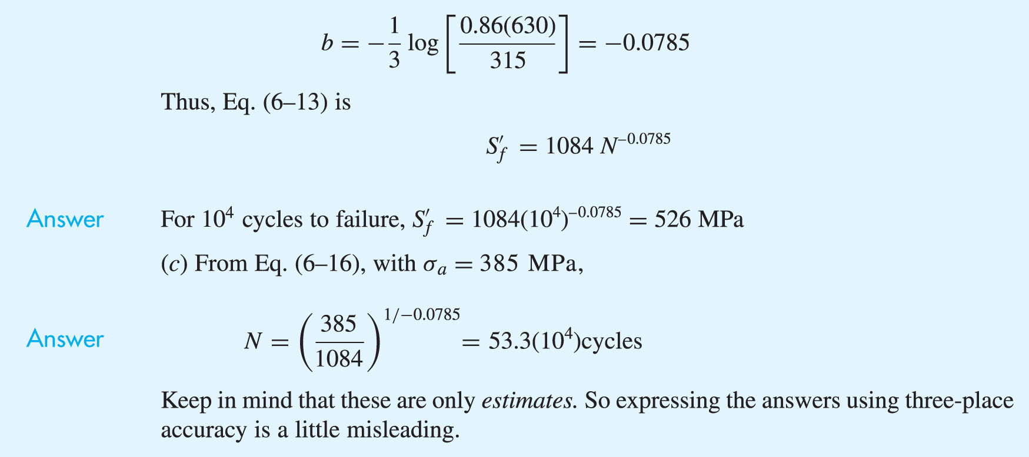
Example 6–2 (continued)

Slide 46
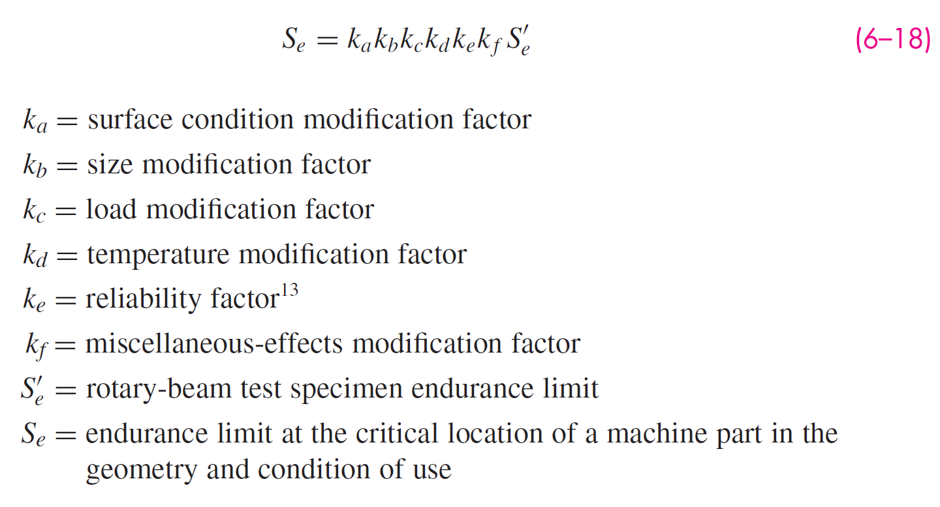
Endurance Limit Modifying Factors
Endurance limit S'_{e} is for carefully prepared and tested specimen
If warranted, S_{e} is obtained from testing of actual parts
When testing of actual parts is not practical, a set of Marin factors are used to adjust the endurance limit

Slide 47


Surface Factor k_{a}
Stresses tend to be high at the surface
Surface finish has an impact on initiation of cracks at localized stress concentrations
Surface factor is a function of ultimate strength. Higher strengths are more sensitive to rough surfaces.

Slide 48

Example 6–3

Slide 49

Size Factor k_{b}
Larger parts have greater surface area at high stress levels
Likelihood of crack initiation is higher
Size factor is obtained from experimental data with wide scatter
For bending and torsion loads, the trend of the size factor data is given by
Applies only for round, rotating diameter
For axial load, there is no size effect, so k_{b} = 1

Slide 50
Size Factor k_{b}
For parts that are not round and rotating, an equivalent round rotating diameter is obtained.
Equate the volume of material stressed at and above 95% of the maximum stress to the same volume in the rotating-beam specimen.
Lengths cancel, so equate the areas.
For a rotating round section, the 95% stress area is the area of a ring,
Equate 95% stress area for other conditions to Eq. (6–22) and solve for d as the equivalent round rotating diameter

Slide 51
Size Factor k_{b}
For non-rotating round,
Equating to Eq. (6-22) and solving for equivalent diameter,
Similarly, for rectangular section h x b, A_{95σ} = 0.05 hb. Equating to Eq. (6–22),
Other common cross sections are given in Table 6–3

Slide 52

Size Factor k_{b}
Table 6–3
A_{95σ} for common non-rotating structural shapes

Slide 53


Example 6–4

Slide 54

Loading Factor k_{c}
Accounts for changes in endurance limit for different types of fatigue loading.
Only to be used for single load types. Use Combination Loading method (Sec. 6–14) when more than one load type is present.

Slide 55

Temperature Factor k_{d}
Endurance limit appears to maintain same relation to ultimate strength for elevated temperatures as at room temperature
This relation is summarized in Table 6–4

Slide 56

Temperature Factor k_{d}
If ultimate strength is known for operating temperature, then just use that strength. Let k_{d} = 1 and proceed as usual.
If ultimate strength is known only at room temperature, then use Table 6–4 to estimate ultimate strength at operating temperature. With that strength, let k_{d} = 1 and proceed as usual.
Alternatively, use ultimate strength at room temperature and apply temperature factor from Table 6–4 to the endurance limit.
A fourth-order polynomial curve fit of the underlying data of Table 6–4 can be used in place of the table, if desired.

Slide 57

Example 6–5

Slide 58

Example 6–5 (continued)

Slide 59
Reliability Factor k_{e}
From Fig. 6–17, S'_{e} = 0.5 S_{ut} is typical of the data and represents 50% reliability.
Reliability factor adjusts to other reliabilities.
Only adjusts Fig. 6–17 assumption. Does not imply overall reliability.
Fig. 6–17

Slide 60

Reliability Factor k_{e}
Simply obtain k_{e} for desired reliability from Table 6–5.
Table 6–5

Slide 61
Miscellaneous-Effects Factor k_{f}
Reminder to consider other possible factors.
Residual stresses
Directional characteristics from cold working
Case hardening
Corrosion
Surface conditioning, e.g. electrolytic plating and metal spraying
Cyclic Frequency
Frettage Corrosion
Limited data is available.
May require research or testing.

Slide 62

Stress Concentration and Notch Sensitivity
For dynamic loading, stress concentration effects must be applied.
Obtain K_{t} as usual (e.g. Appendix A–15)
For fatigue, some materials are not fully sensitive to K_{t} so a reduced value can be used.
Define K_{f} as the fatigue stress-concentration factor.
Define q as notch sensitivity, ranging from 0 (not sensitive) to 1 (fully sensitive).
For q = 0, K_{f} = 1
For q = 1, K_{f} = K_{t}

Slide 63

Notch Sensitivity
Obtain q for bending or axial loading from Fig. 6–20.
Then get K_{f} from Eq. (6–32): K_{f} = 1 + q( K_{t} – 1)
Fig. 6–20

Slide 64

Notch Sensitivity
Obtain q_{s} for torsional loading from Fig. 6–21.
Then get K_{fs} from Eq. (6–32): K_{fs} = 1 + q_{s}( K_{ts} – 1)
Fig. 6–21

Slide 65



Notch Sensitivity
Alternatively, can use curve fit equations for Figs. 6–20 and 6–21 to get notch sensitivity, or go directly to K_{f} .
For steels, with S_{ut} in kpsi
Bending or axial:
Torsion:

Slide 66
Notch Sensitivity for Cast Irons
Cast irons are already full of discontinuities, which are included in the strengths.
Additional notches do not add much additional harm.
Recommended to use q = 0.2 for cast irons.

Slide 67



Example 6–6

Slide 68
Application of Fatigue Stress Concentration Factor
Use K_{f} as a multiplier to increase the nominal stress.
Some designers (and previous editions of textbook) sometimes applied 1/ K_{f} as a Marin factor to reduce S_{e} .
For infinite life, either method is equivalent, since
For finite life, increasing stress is more conservative. Decreasing S_{e} applies more to high cycle than low cycle.

Slide 69



Example 6–7

Slide 70

Example 6–8

Slide 71

Example 6–8 (continued)

Slide 72

Example 6–8 (continued)

Slide 73


Example 6–9
Fig. 6–22

Slide 74


Example 6–9 (continued)
Fig. 6–22

Slide 75

Example 6–9 (continued)

Slide 76


Example 6–9 (continued)

Slide 77

Example 6–9 (continued)

Slide 78
Characterizing Fluctuating Stresses
The S-N diagram is applicable for completely reversed stresses
Other fluctuating stresses exist
Sinusoidal loading patterns are common, but not necessary

Slide 79

Fluctuating Stresses
General Fluctuating
Repeated
Completely Reversed
Fig. 6–23

Slide 80


Characterizing Fluctuating Stresses
Fluctuating stresses can often be characterized simply by the minimum and maximum stresses, σ_{min} and σ_{max}
Define σ_{m} as midrange steady component of stress (sometimes called mean stress) and σ_{a} as amplitude of alternating component of stress

Slide 81

Characterizing Fluctuating Stresses
Other useful definitions include stress ratio
and amplitude ratio

Slide 82

Application of K_{f} for Fluctuating Stresses
For fluctuating loads at points with stress concentration, the best approach is to design to avoid all localized plastic strain.
In this case, K_{f} should be applied to both alternating and midrange stress components.
When localized strain does occur, some methods (e.g. nominal mean stress method and residual stress method) recommend only applying K_{f} to the alternating stress.
The Dowling method recommends applying K_{f} to the alternating stress and K_{fm} to the mid-range stress, where K_{fm} is

Slide 83
Fatigue Failure for Fluctuating Stresses
Vary the σ_{m} and σ_{a} to learn about the fatigue resistance under fluctuating loading
Three common methods of plotting results follow.

Slide 84

Modified Goodman Diagram
Midrange stress is plotted on abscissa
All other components of stress are plotted on the ordinate
Fig. 6–24

Slide 85

Master Fatigue Diagram
Displays four stress components as well as two stress ratios
Fig. 6–26

Slide 86

Plot of Alternating vs Midrange Stress
Probably most common and simple to use is the plot of σ_{a} vs σ_{m}
Has gradually usurped the name of Goodman or Modified Goodman diagram
Modified Goodman line from S_{e} to S_{ut} is one simple representation of the limiting boundary for infinite life

Slide 87

Plot of Alternating vs Midrange Stress
Experimental data on normalized plot of σ_{a} vs σ_{m}
Demonstrates little effect of negative midrange stress
Fig. 6–25

Slide 88

Commonly Used Failure Criteria
Five commonly used failure criteria are shown
Gerber passes through the data
ASME-elliptic passes through data and incorporates rough yielding check
Fig. 6–27

Slide 89
Commonly Used Failure Criteria
Modified Goodman is linear, so simple to use for design. It is more conservative than Gerber.
Soderberg provides a very conservative single check of both fatigue and yielding.
Fig. 6–27

Slide 90
Commonly Used Failure Criteria
Langer line represents standard yield check.
It is equivalent to comparing maximum stress to yield strength.
Fig. 6–27

Slide 91



Equations for Commonly Used Failure Criteria
Intersecting a constant slope load line with each failure criteria produces design equations
n is the design factor or factor of safety for infinite fatigue life

Slide 92
Summarizing Tables for Failure Criteria
Tables 6–6 to 6–8 summarize the pertinent equations for Modified Goodman, Gerber, ASME-elliptic, and Langer failure criteria
The first row gives fatigue criterion
The second row gives yield criterion
The third row gives the intersection of static and fatigue criteria
The fourth row gives the equation for fatigue factor of safety
The first column gives the intersecting equations
The second column gives the coordinates of the intersection

Slide 93

Summarizing Table for Modified Goodman

Slide 94

Summarizing Table for Gerber

Slide 95

Summarizing Table for ASME-Elliptic

Slide 96


Example 6–10

Slide 97

Example 6–10 (continued)

Slide 98


Example 6–10 (continued)
Fig. 6–28

Slide 99

Example 6–10 (continued)

Slide 100

Example 6–10 (continued)
Fig. 6–28

Slide 101


Example 6–10 (continued)
Fig. 6–29

Slide 102


Example 6–11
Fig. 6–30a

Slide 103

Example 6–11 (continued)

Slide 104

Example 6–11 (continued)

Slide 105


Example 6–11 (continued)
Fig. 6–30b

Slide 106

Example 6–11 (continued)

Slide 107

Example 6–12

Slide 108

Example 6–12 (continued)

Slide 109

Example 6–12 (continued)

Slide 110

Example 6–12 (continued)

Slide 111
Fatigue Criteria for Brittle Materials
For many brittle materials, the first quadrant fatigue failure criteria follows a concave upward Smith-Dolan locus,
Or as a design equation,
For a radial load line of slope r, the intersection point is
In the second quadrant,

Slide 112
Fatigue Criteria for Brittle Materials
Table A–24 gives properties of gray cast iron, including endurance limit
The endurance limit already includes k_{a} and k_{b}
The average k_{c} for axial and torsional is 0.9

Slide 113


Example 6–13
Fig. 6–31a

Slide 114

Example 6–13 (continued)

Slide 115

Example 6–13 (continued)

Slide 116

Example 6–13 (continued)

Slide 117

Example 6–13 (continued)
Fig. 6–31b

Slide 118
Torsional Fatigue Strength
Testing has found that the steady-stress component has no effect on the endurance limit for torsional loading if the material is ductile, polished, notch-free, and cylindrical.
However, for less than perfect surfaces, the modified Goodman line is more reasonable.
For pure torsion cases, use k_{c} = 0.59 to convert normal endurance strength to shear endurance strength.
For shear ultimate strength, recommended to use

Slide 119

Combinations of Loading Modes
When more than one type of loading (bending, axial, torsion) exists, use the Distortion Energy theory to combine them.
Obtain von Mises stresses for both midrange and alternating components.
Apply appropriate K_{f} to each type of stress.
For load factor, use k_{c} = 1. The torsional load factor (k_{c} = 0.59) is inherently included in the von Mises equations.
If needed, axial load factor can be divided into the axial stress.

Slide 120
Static Check for Combination Loading
Distortion Energy theory still applies for check of static yielding
Obtain von Mises stress for maximum stresses (sum of midrange and alternating)
Stress concentration factors are not necessary to check for yielding at first cycle
Alternate simple check is to obtain conservative estimate of σ'_{max} by summing σ'_{a} and σ'_{m}

Slide 121

Example 6–14

Slide 122

Example 6–14 (continued)

Slide 123

Example 6–14 (continued)

Slide 124

Example 6–14 (continued)

Slide 125


Example 6–14 (continued)
Fig. 6–32

Slide 126
Example 6–14 (continued)

Slide 127


Example 6–14 (continued)

Slide 128

Varying Fluctuating Stresses
Loading patterns may be complex
Simplifications may be necessary
Small fluctuations may be negligible compared to large cycles
Fig. 6–33

Slide 129


Cumulative Fatigue Damage
A common situation is to load at σ₁ for n₁ cycles, then at σ₂ for n₂ cycles, etc.
The cycles at each stress level contributes to the fatigue damage
Accumulation of damage is represented by the Palmgren-Miner cycle-ratio summation rule, also known as Miner’s rule
where n_{i} is the number of cycles at stress level σ_{i} and N_{i} is the number of cycles to failure at stress level σ_{i}
c is experimentally found to be in the range 0.7 < c < 2.2, with an average value near unity
Defining D as the accumulated damage,

Slide 130


Example 6–15
Cycle number | σ_{max} | σ_{min} | σ_{a} | σ_{m}
1 | 560 | -420 | 490 | 70
2 | 420 | 280 | 70 | 350
3 | -140 | -420 | 70 | -210
Fig. 6–33

Slide 131

Example 6–15 (continued)

Slide 132

Example 6–15 (continued)

Slide 133

Example 6–15 (continued)

Slide 134

Illustration of Miner’s Rule
Figure 6–34 illustrates effect of Miner’s rule on endurance limit and fatigue failure line.
Note that the damaged material line is predicted to be parallel to original material line.
Fig. 6–34

Slide 135
Weaknesses of Miner’s Rule
Miner’s rule fails to agree with experimental results in two ways
It predicts the static strength S_{ut} is damaged.
It does not account for the order in which the stresses are applied

Slide 136

Manson’s Method
Manson’s method overcomes deficiencies of Miner’s rule.
It assumes all fatigue lines on the S-N diagram converge to a common point at 0.9S_{ut} at 10³ cycles.
It requires each line to be constructed in the same historical order in which the stresses occur.
Fig. 6–35

Slide 137
Surface Fatigue Strength
When two surfaces roll or roll and slide against one another, a pitting failure may occur after a certain number of cycles.
The surface fatigue mechanism is complex and not definitively understood.
Factors include Hertz stresses, number of cycles, surface finish, hardness, lubrication, and temperature

Slide 138

Surface Fatigue Strength
From Eqs. (3–73) and (3–74), the pressure in contacting cylinders,
Converting to radius r and width w instead of length l,
Define p_{max} as surface endurance strength (also called contact strength, contact fatigue strength, or Hertzian endurance strength)

Slide 139



Surface Fatigue Strength
Combining Eqs. (6–61) and (6–63),
K₁ is known as Buckingham’s load-stress factor, or wear factor
In gear studies, a similar factor is used,
From Eq. (6–64), with material property terms incorporated into an elastic coefficient C_{P}

Slide 140

Surface Fatigue Strength
Experiments show the following relationships

Slide 141

Surface Fatigue Strength
A longstanding correlation in steels between S_{C} and H_{B} at 10⁸ cycles is
AGMA uses

Slide 142


Surface Fatigue Strength
Incorporating design factor into Eq. (6–66),
Since this is nonlinear in its stress-load transformation, the definition of n_{d} depends on whether load or stress is the primary consideration for failure.
If the loss of function is focused on the load,
If the loss of function is focused on the stress,

